Slide 1

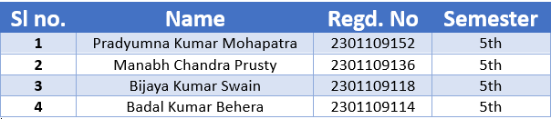
Face Recognition with Attendance System
Seminar On Summer Internship And Research Experience
Presented By:-

Slide 2

INTRODUCTION
The Need for Smarter Attendance
Attendance tracking is a universal, daily requirement in educational institutions and workplaces. Traditionally, this process relies on manual methods or basic biometric systems.
However, these methods are often slow, prone to human error, and can be easily manipulated. They also involve physical contact, which is less ideal in modern environments.
Our solution leverages face recognition technology to provide a fast, secure, and completely contactless attendance system.

Slide 3
PROBLEM
01
02
03
Time Consumption
Proxy Attendance
Biometric Limitations
Manual roll call significantly reduces valuable instructional or working time, impacting productivity.
Existing systems are vulnerable to 'buddy punching' or unauthorized attendance marking, compromising data integrity.
Contact-based biometric devices (fingerprint, iris) raise hygiene concerns, require regular maintenance, and are often costly to implement and scale.

Slide 4
Real-time Detection
Automated Record-Keeping
To accurately detect and recognize faces in live video streams.
To automatically log attendance entries into a structured CSV format.
THE CORE OBJECTIVES
Voice Confirmations
Intuitive Dashboard
To provide instant audio feedback upon successful attendance marking.
To visualize attendance data through an easy-to-understand interface.

Slide 5
Real-time Detection
Automated Record-Keeping
To accurately detect and recognize faces in live video streams.
To automatically log attendance entries into a structured CSV format.
THE CORE OBJECTIVES
Voice Confirmations
Intuitive Dashboard
To provide instant audio feedback upon successful attendance marking.
To visualize attendance data through an easy-to-understand interface.

Slide 6
Existing System vs Proposed System
Our system offers a significant leap in convenience, hygiene, and data accuracy.
Method | Manual roll-call, RFID, Fingerprint scanners | Face Recognition (OpenCV + K-Nearest Neighbors)
Contact | High (physical interaction) | None (contactless)
Efficiency | Slow, error-prone, time-consuming | Fast, accurate, automated CSV logging
Feedback | Minimal or none | Real-time voice confirmation and dashboard visualization

Slide 7

Programming Language
Python
Key Technologies & Libraries
Core Libraries
OpenCV: For real-time video capture, image processing, and face detection (Haar Cascade).
NumPy & Pickle: Essential for efficient numerical operations and serialization/deserialization of face data.
scikit-learn: Implements the K-Nearest Neighbors (KNN) algorithm for robust face recognition.
Pandas & Streamlit: Pandas for data manipulation (CSV), and Streamlit for creating the interactive attendance dashboard.
win32com: Facilitates text-to-speech functionality for voice confirmations.

Slide 8






SYSTEM ARCHITECTURE
Video Stream Capture
Face Detection
A standard webcam continuously captures the live video feed.
Haar Cascade Classifier identifies and isolates human faces
within the video frames.
Preprocessing
Face Recognition
Detected faces are resized to a uniform 50x50 pixel resolution
and flattened into feature vectors.
K-Nearest Neighbors (KNN) classifier processes feature vectors
to recognize individual identities.
Attendance Logging
Visualization Dashboard
Recognized names and timestamps are instantly saved to
a CSV file.
A Streamlit-based dashboard provides real-time display and
analysis of attendance data.

Slide 9
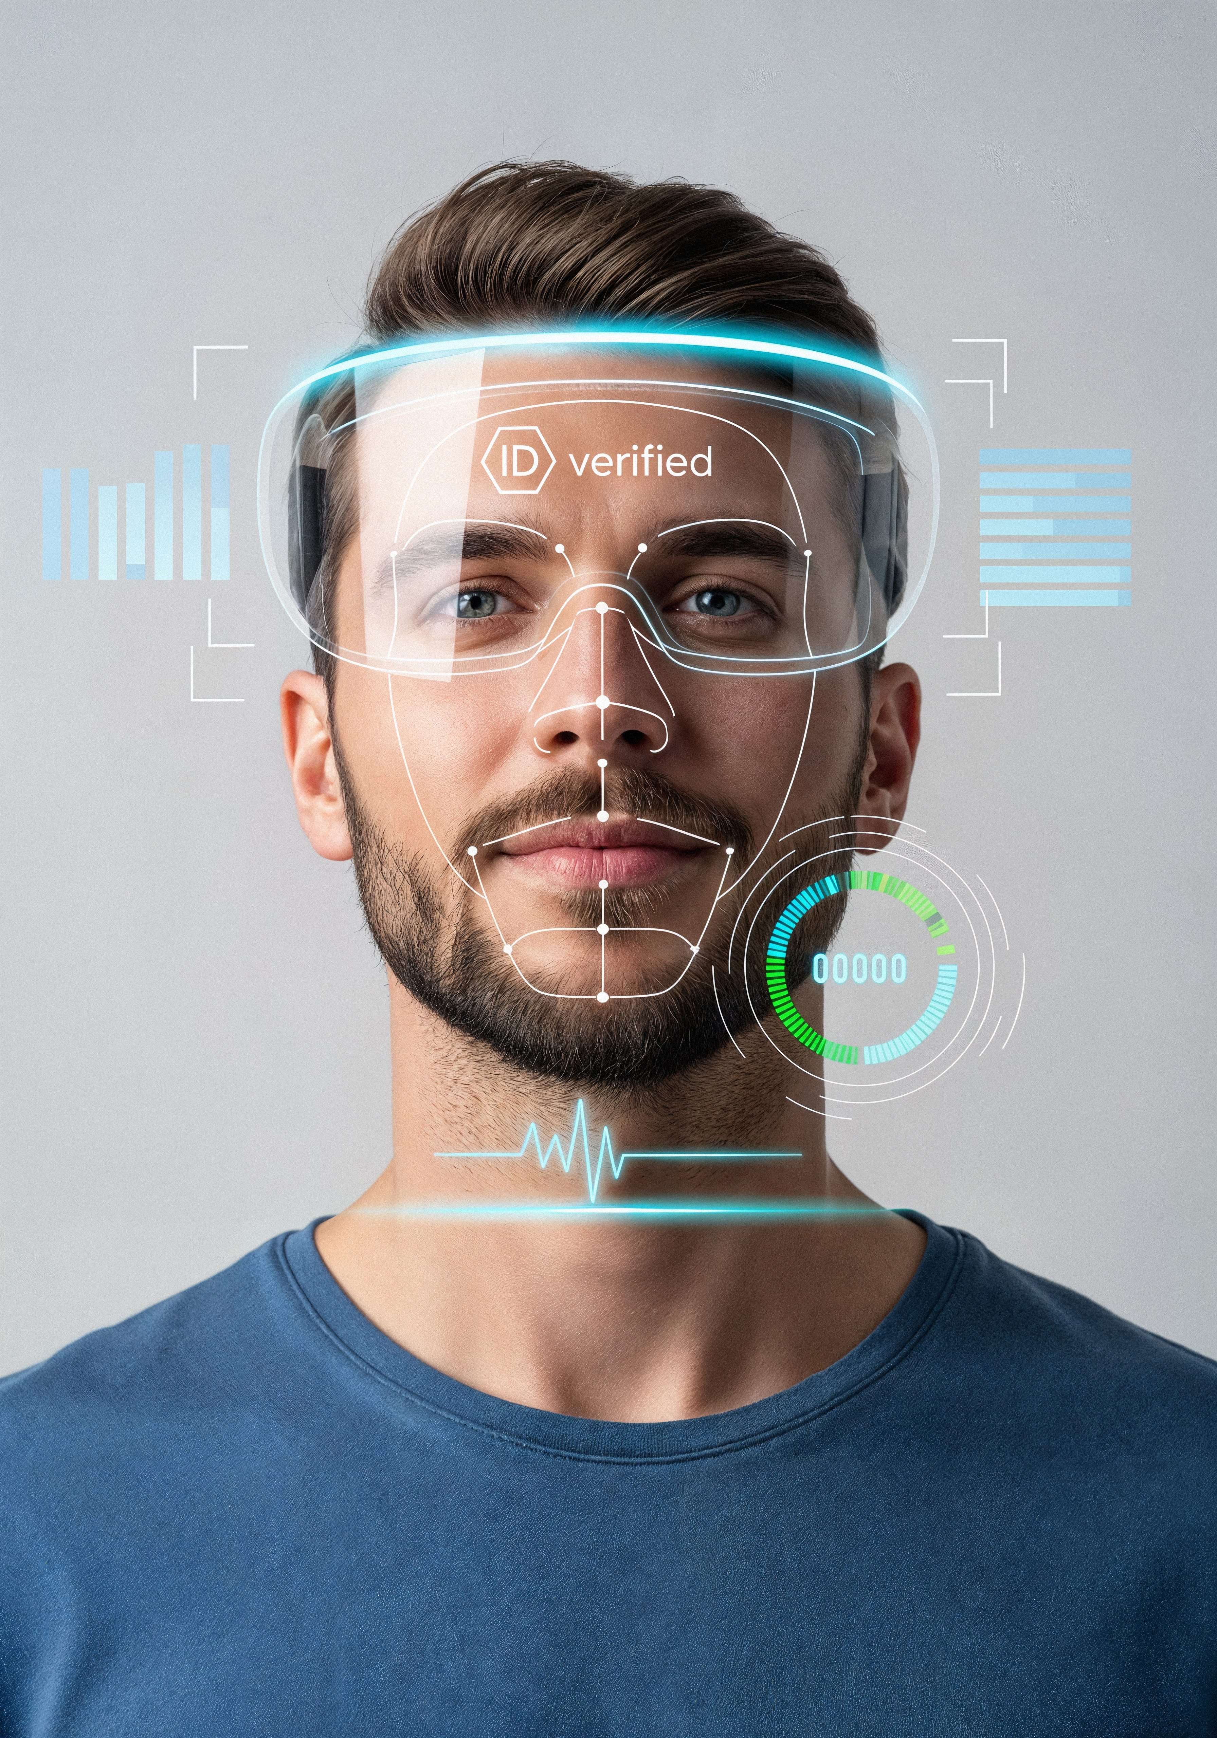
Face Detection: Haar Cascade Classifier
The initial step in our recognition pipeline is accurate face detection. We utilize the Haar Cascade Classifier, a highly efficient object detection algorithm.
Converts input video frames to grayscale for simplified processing and feature extraction.
Applies a series of Haar-like features to identify facial regions.
Draws a bounding box around each detected face.
The detected face area is then cropped and resized to a standard 50x50 pixel dimension, ensuring consistency for the subsequent recognition step.

Slide 10



Data Collection & Preparation
Sample Capture
Feature Storage
Label Mapping
For each individual, 100 distinct image samples are captured to create a diverse training dataset.
The processed facial features (flattened 50x50 pixel data) are stored in faces_data.pkl.
Corresponding identity labels (names) for each set of samples are stored in names.pkl.
This collected and pre-processed data forms the crucial dataset for training our face recognition model, allowing it to learn and differentiate between individuals.

Slide 11
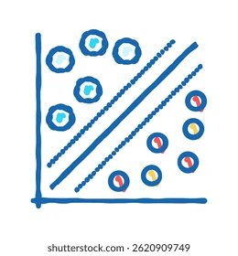
Recognition using K-Nearest Neighbors (KNN)
For classifying and recognizing faces, we employ the K-Nearest Neighbors (KNN) algorithm from the scikit-learn library.
We configured the classifier with k=5, meaning it considers the 5 closest neighbors in the feature space to determine a face's identity.
The model is trained on the collected faces_data.pkl (features) and names.pkl (labels).
In real-time, for a new detected face, KNN predicts the most probable identity based on its similarity to known face samples.
KNN is particularly effective for this application due to its simplicity and good performance on relatively small datasets, making it suitable for practical deployments.

Slide 12



Attendance Marking Logic
Persistent Data Logging
Instant Voice Confirmation
Duplicate Entry Prevention
Attendance records are automatically saved daily as Attendance_<date>.csv, containing precise Name and Time columns for easy management.
The system provides immediate audio feedback, announcing "Attendance taken for [recognized name]," enhancing real-time user verification.
A sophisticated internal 'marked set' is utilized to ensure that each recognized individual is recorded only once per session, maintaining data integrity.
Once a face is recognized, our system proceeds with a well-defined logic to mark and confirm attendance, ensuring accuracy and a seamless user experience.

Slide 13
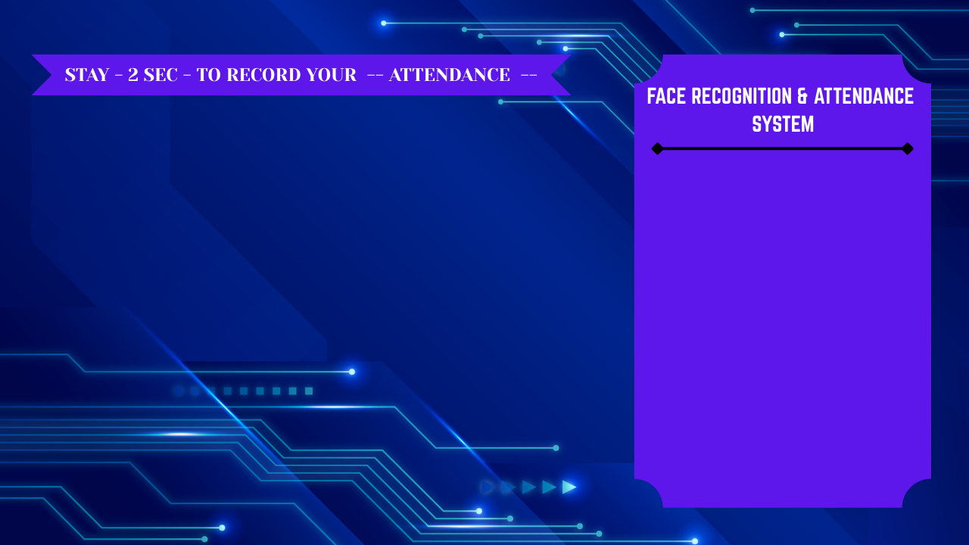
Integration with Background UI
Our attendance system provides a seamless and intuitive user experience through its integrated graphical interface, designed for real-time monitoring and ease of use.
A custom background template (`background.png`) is loaded, ensuring a professional and consistent visual theme across the application.
The live video feed from the camera is dynamically placed within a dedicated, allocated region of the UI, offering immediate visual feedback of the captured stream.
Recognized user names are displayed on a real-time side panel, providing instantaneous visual confirmation of attendance events as they occur.
This integrated design ensures that administrators have a clear and organized view of the attendance process, enhancing usability and data transparency.

Slide 14
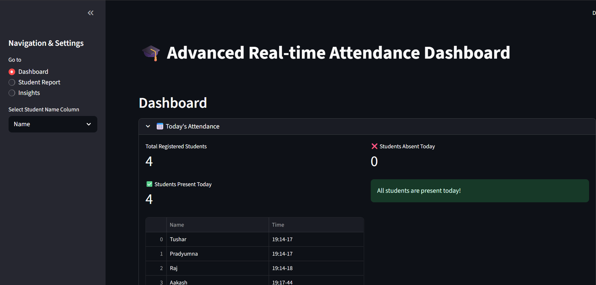
Interactive Dashboard
Real-time Attendance Monitoring
Our system integrates a dynamic dashboard built with Streamlit, providing a user-friendly interface for real-time attendance tracking and management.
The dashboard seamlessly loads daily attendance data directly from the generated CSV files.
Leveraging Pandas DataFrame capabilities, the raw data is transformed into a clean, intuitive tabular display.
A crucial feature is the automatic refresh mechanism, updating every 2 seconds to ensure administrators always have the most current attendance records at their fingertips.
This interactive view facilitates quick oversight and data verification, significantly enhancing operational efficiency.

Slide 15
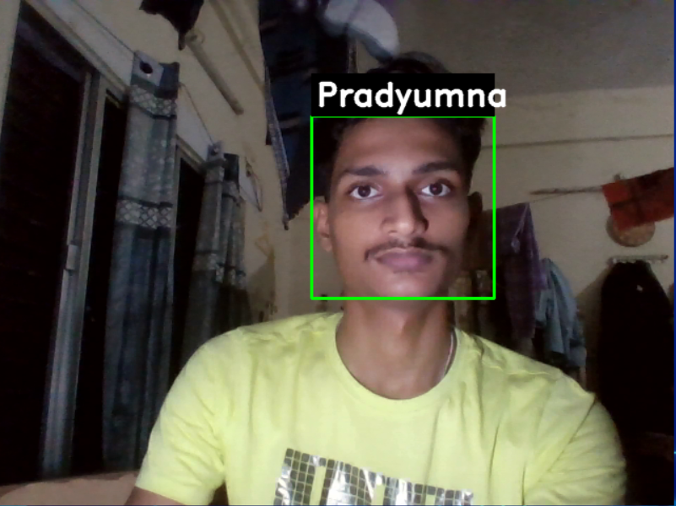
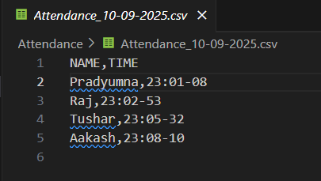
Output Screenshots
Live Detection Window
Attendance CSV Log
Streamlit Dashboard
Witness the system in action: real-time face detection with recognized names overlayed directly on the video feed, confirming successful identification.
Verify attendance records through the automatically updated CSV file, meticulously logging precise names and timestamps for daily record-keeping.
Engage with the interactive dashboard, offering a clean, real-time overview of attendance data for effortless monitoring and management.

Slide 16
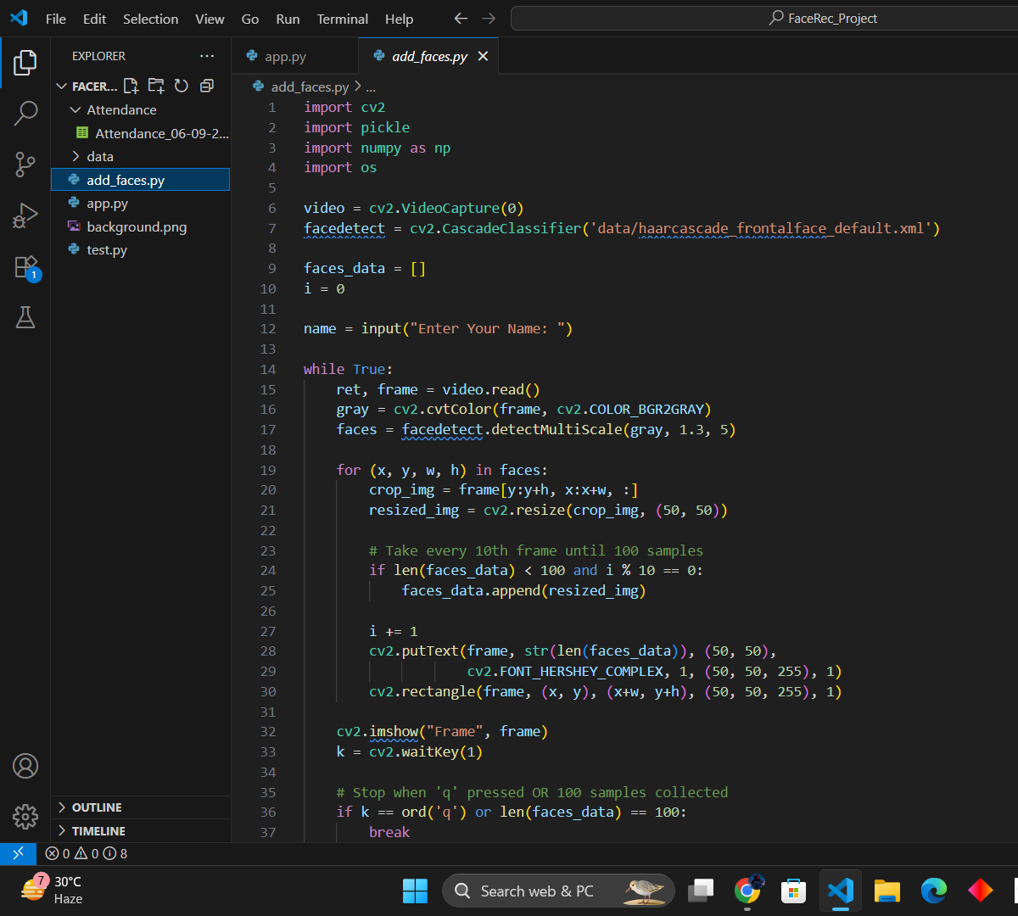
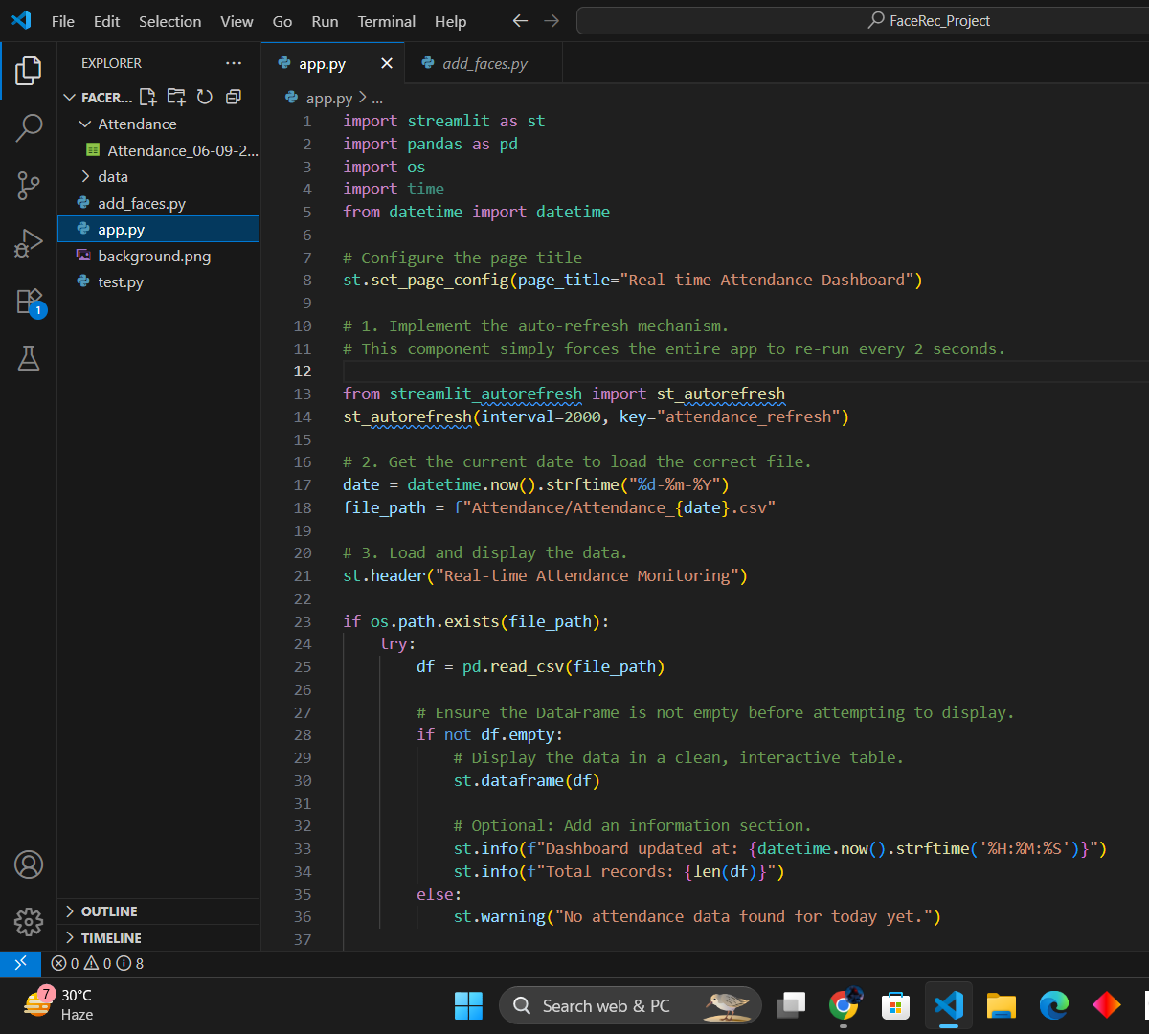
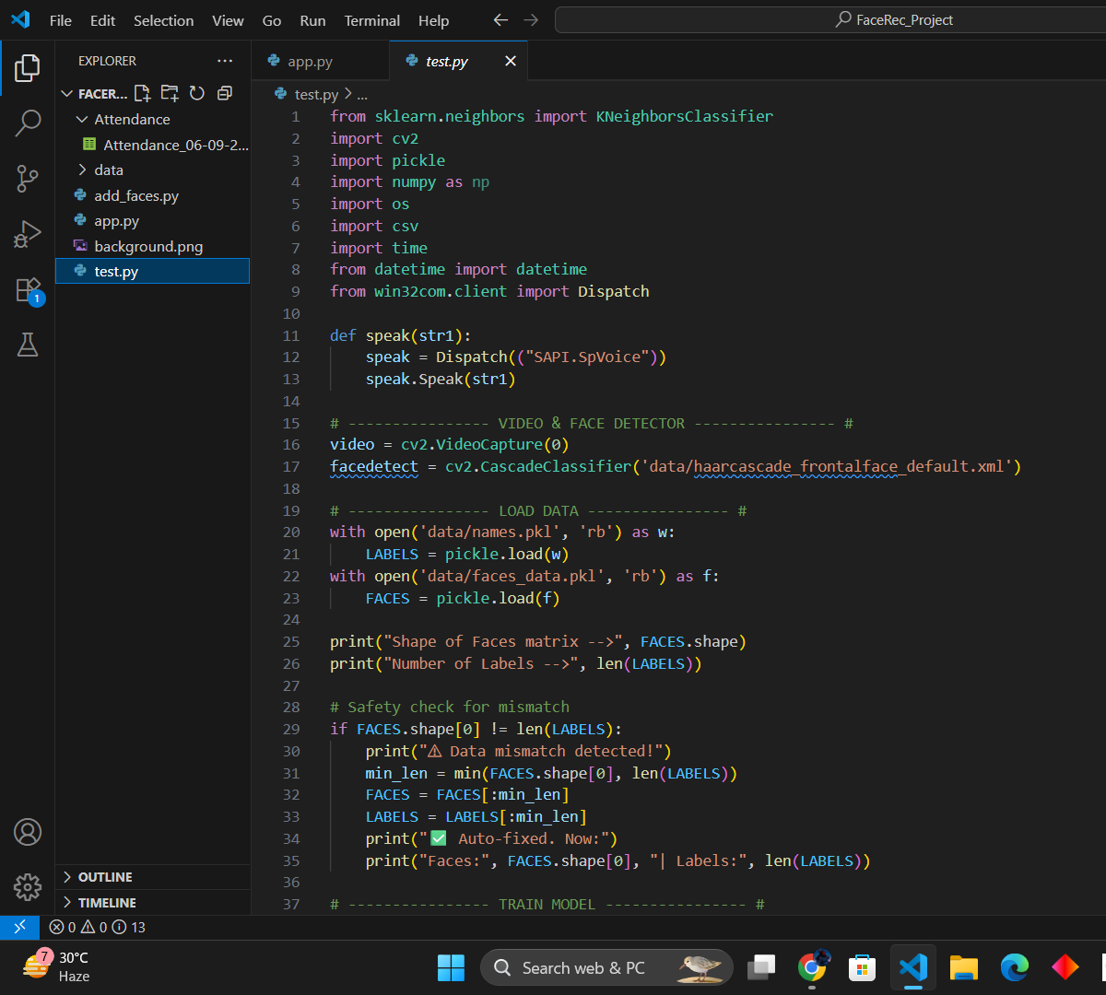
Code Snippets
add_faces.py
app.py
main.py

Slide 17
PRACTICAL IMPLEMENTATION

Slide 18

Advantages & Limitations
Advantages
Limitations
Contactless, fast, and secure: Eliminates physical touchpoints, speeding up the process and enhancing hygiene.
Accuracy depends on lighting/camera quality: Performance can be affected by poor illumination or low-resolution cameras.
Prevents proxy attendance: Ensures that only the authorized individual can mark their presence, curbing fraudulent practices.
Faces with masks/sunglasses reduce accuracy: Partial facial obstructions can hinder the system's ability to recognize individuals effectively.
Automated record keeping: Streamlines administrative tasks by automatically logging attendance data with precise timestamps.
Real-time confirmation with speech: Provides instant audio feedback, enhancing user experience and verification.

Slide 19



Future Scope
Enhanced Accuracy with Deep Learning
Integrate advanced CNN models like FaceNet to significantly boost recognition precision and robustness in varied conditions.
Seamless Cloud Integration
Develop cloud-based reporting and data synchronization for accessible, secure, and scalable attendance management from anywhere.
Mobile Application Support
Introduce a dedicated mobile app for administrators to monitor attendance, generate reports, and manage user data on the go.

Slide 20

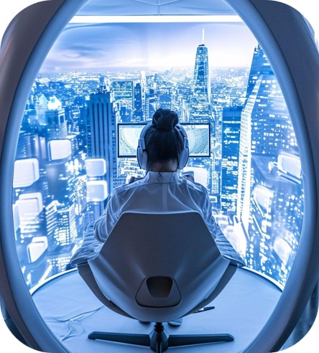


Conclusion
Real-time Face Recognition System
Successfully developed a robust, real-time face recognition attendance system from scratch, demonstrating practical computer vision application.
Automated & Reliable Attendance
The system automates attendance tracking, drastically reducing manual effort, saving time, and significantly increasing data reliability and accuracy.
Comprehensive Data Management
Features include both automated CSV logging for detailed record-keeping and an interactive Streamlit dashboard for real-time monitoring and visualization.

Slide 21
Thank You
We appreciate your time and attention.
Questions? We'd be happy to discuss further.

